Slide 1
LLHBA
January 15th, 2020
Dinner Meeting

Slide 2
Welcome to our Special Guest!
Robert Simpson – Ministry of Transportation

Slide 3
Upgrade your Quotes
Impress clients and win more work with SumoQuote
CHBA members get 20% off
Visit CHBA.ca to see how the CHBA National Advantages program can benefit you.

Slide 4
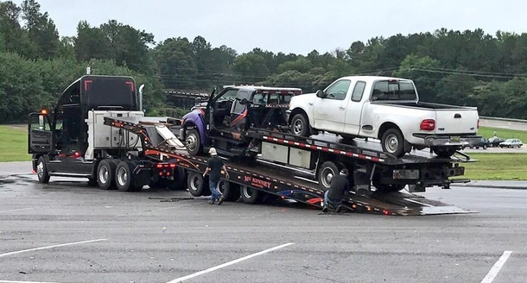
You might be having a bad day when…

Slide 5
New rate framework for 2020 is now public.
The average premium rate has been reduced by 17 per cent for 2020.
You can now view your 2020 individual premium rates by logging in to our online services and selecting “analyze your rates and past claims costs”.
NOTE:
Construction rates fall under class categories G1 to G5.

Slide 6
NEWS FROM PERTH TOWN HALL…
Updated Notice for 2020 Budget
Please be advised that the 2020 Budget discussions have been postponed until February 2020.
Details will be provided once they are available.
COPY OF DRAFT BUDGET IS POSTED ON LLHBA Guides Hub

Slide 7
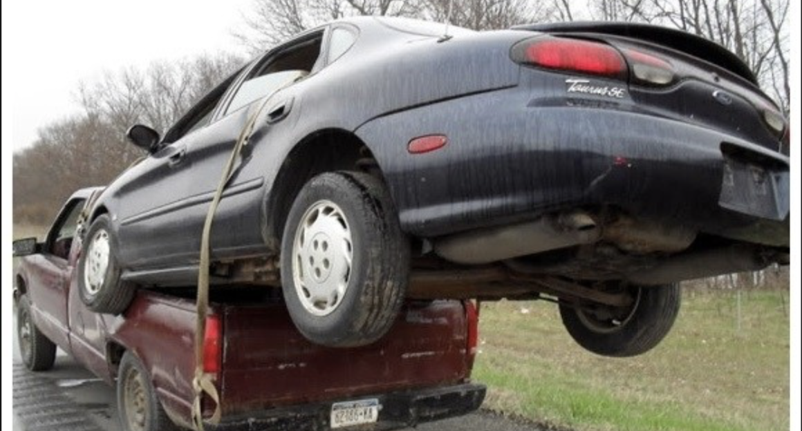

Slide 8
WINTER 2020 NATIONAL CODE CONSULTATION
The National Research Council of Canada (NRC) needs public consultation on proposed changes to the national construction codes.
Runs from January 13, 2020 through March 13, 2020.
The majority of the changes in NRC’s consultation are related to:
Large Farm Buildings,
Accessibility,
Energy Efficiency,
Earthquake and Structural design,
Referenced document table,
Plumbing, and
Others.

Slide 9
LLHBA Members are invited to attend…
CREATING HOUSING SOLUTIONS IN LANARK COUNTY
Thursday, February 20, 2020
1pm - 8pm
Presentations and displays
Dinner and Discussion
Carleton Place Arena,
75 Neelin Street
Meet with municipalities in Lanark County, community groups, youth organizations, women’s groups, housing providers, seniors, legal aid, funding agencies and more.
PRESENTED BY THE HOUSING FORUM OF:

Slide 10
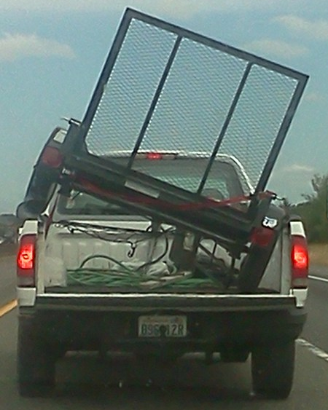
Tie down
or tow?

Slide 11
NEWS FROM OHBA
In March 2020, Tarion will move to a Board of 12 in total from the current 16. It will be 4 BUILDERS + 4 GOVERNMENT APPOINTEES + 4 PUBLIC APPLICTION APPOINTEES.
OHBA has the responsibility to nominate the 4 Builder members to the formal Tarion committee to consider. At this point, 2 existing builder appointees will remain – meaning OHBA needs to nominate a minimum of 2 builders to serve on this new Tarion Board.

Slide 12
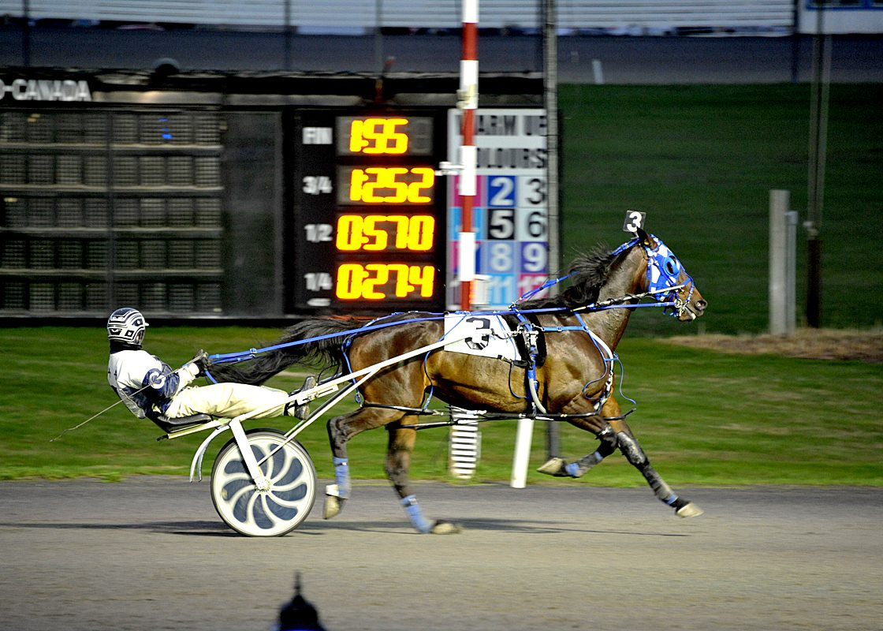
LLHBA Winter Party!
When: Sunday, Feb. 16, 2020.
Where: Rideau Carleton Raceway & Casino.
Cost: $75 per person.
RSVP to Bill or Judy Brady
as soon as possible!

